Slide 1
Requirements Modelling Principles
Requirements Modeling Principles serve as guidelines to ensure that system requirements are well-defined, achievable, and beneficial for the stakeholders. Below are the principles:
1. Clarity and Precision
Explanation: Requirements should be written in a way that leaves no room for confusion. Ambiguity can lead to misunderstandings and errors in the system design.
Analogy: Think of writing a recipe. If we say, “Add some sugar,” it can mean different amounts to different people. But if you write, “Add 2 teaspoons of sugar,” it leaves no doubt.
Example: Instead of saying “The system should respond quickly,” say “The system should respond to user input within 2 seconds.”

Slide 2
Requirements Modelling Principles..
2. Consistency
Explanation: All requirements should align with each other and not contradict one another. Inconsistencies can lead to conflicts during development.
Analogy: Imagine building a car. If one requirement specifies a manual transmission (which requires the driver to change gears) and another specifies an automatic transmission, the car can't have both.
Example: If a requirement says, “The system should send an email notification,” another requirement shouldn't say “The system should not send notifications.”

Slide 3
Requirements Modelling Principles..
3. Feasibility
Explanation: The requirements should be realistic and achievable within the given constraints of technology, budget, and time.
Analogy: If you plan to climb a mountain, you need to ensure you have the right equipment and enough time. Saying “I will climb Mount Everest tomorrow” isn’t feasible without preparation.
Example: Requiring a system to process 1 million transactions per second might not be feasible with the current hardware.

Slide 4
Requirements Modelling Principles..
4. Traceability
Explanation: There should be a way to track each requirement from its origin to its implementation. This helps in ensuring nothing is missed and makes updates easier.
Analogy: Think of a parcel delivery system where each parcel has a tracking number. You can check where the parcel is at any point in time.
Example: Every requirement should be linked to its source, like a stakeholder's feedback or a specific project objective.

Slide 5
Requirements Modelling Principles..
5. Stakeholder Involvement
Explanation: All relevant stakeholders (e.g., users, clients, developers) should be involved in defining requirements to ensure their needs and expectations are captured.
Analogy: If you’re designing a house, you need input from the people who will live there, not just the architect or builder.
Example: For a customer support system, involve support agents to understand what features would make their work easier.

Slide 6
Domain Analysis and System Models
Domain Analysis and System Models involve understanding the problem domain and creating representations that ensure the system aligns with user needs and goals. This section focuses on three types of models: Context Models, Behavioural Models, and Data Models.

Slide 7
Domain Analysis and System Models..
Context Models: Understand system boundaries and external entities.
Behavioural Models: Capture and validate how the system behaves and interacts.
Data Models: Show how data is structured and related.
Consistency Across Models: All these models must align to provide a complete, consistent understanding of the system.

Slide 8
Domain Analysis and System Models : Context Models
Purpose
Define the boundaries of the system.
Identify external entities (e.g., users, other systems, hardware) that interact with it.
Show the flow of information between the system and these external entities.
Representation
Context Diagrams: Depict the system as a single entity in the center, with arrows or lines indicating data flow or interactions with external entities.
Application
Clarify external interfaces (e.g., APIs, user interfaces).
Understand constraints from the environment (e.g., regulatory, technological).
Example
Library Management System Context Diagram:
The system interacts with Library Members (to borrow/return books), Book Suppliers (to obtain new books), and a Payment Gateway (for late fees or membership payments).
Visually, place the “Library Management System” in the middle and show labeled arrows connecting it to “Library Members,” “Book Suppliers,” and “Payment Gateway.”

Slide 9
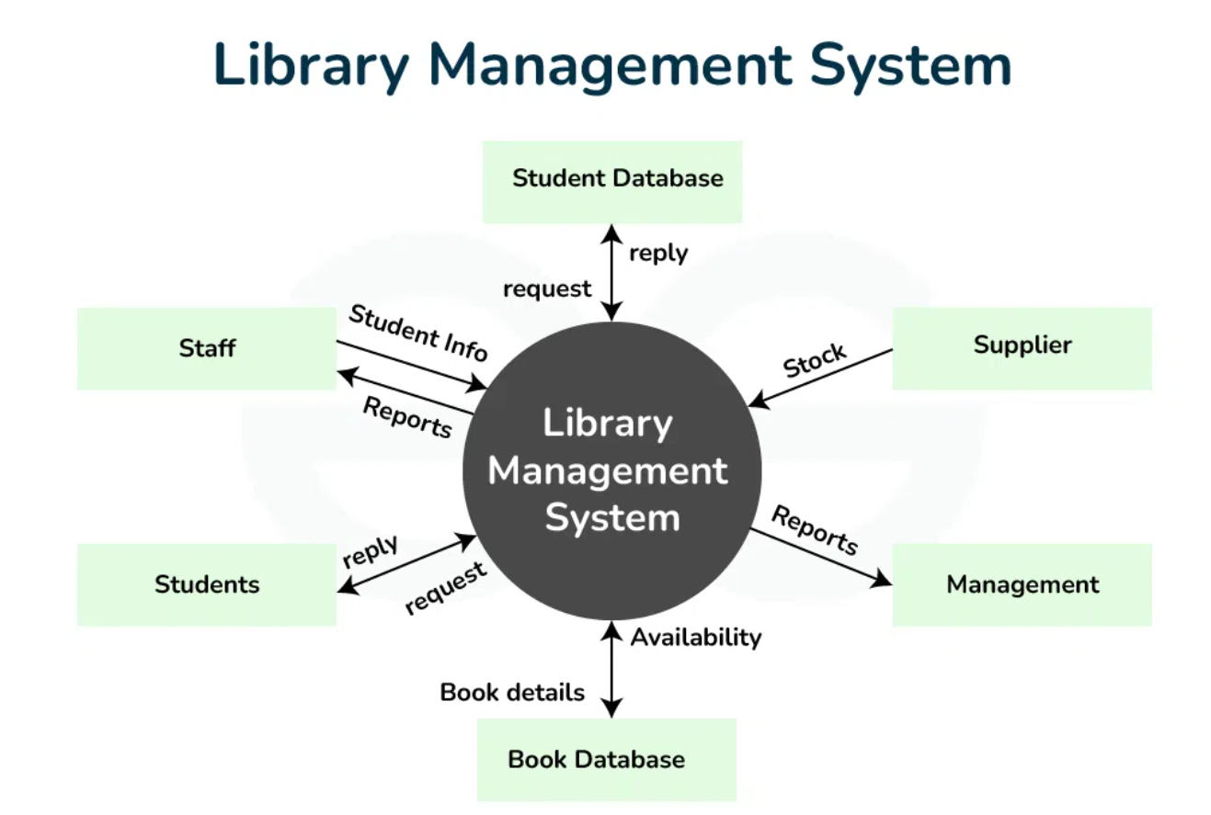
Domain Analysis and System Models : Context Models using Context Diagram

Slide 10
Domain Analysis and System Models : Behavioural Models
Focus
Capture the dynamic behavior: how the system functions over time.
Illustrate how the system responds to events and user interactions.
Techniques
Use Case Diagrams
Show functions (use cases) provided by the system.
Identify actors (users or external systems) that interact with those functions.
Example: “Place an Order”, “Search Books”, “Enroll in Course”.
State Transition Diagrams
Depict the system’s states and how it transitions from one state to another based on events.
Example states for an online shopping system: Browsing, Added to Cart, Order Placed, Order Shipped, Order Delivered; Using elevator
Sequence Diagrams
Show the sequence of interactions between objects or components over time.
Emphasize message passing or function calls among different parts of the system.
Example: When a customer places an order online, the system checks inventory, and the payment gateway processes payment.
Outcome
Validation that the system’s behavior meets functional requirements.
Helps to communicate system logic and user interaction flows.

Slide 11
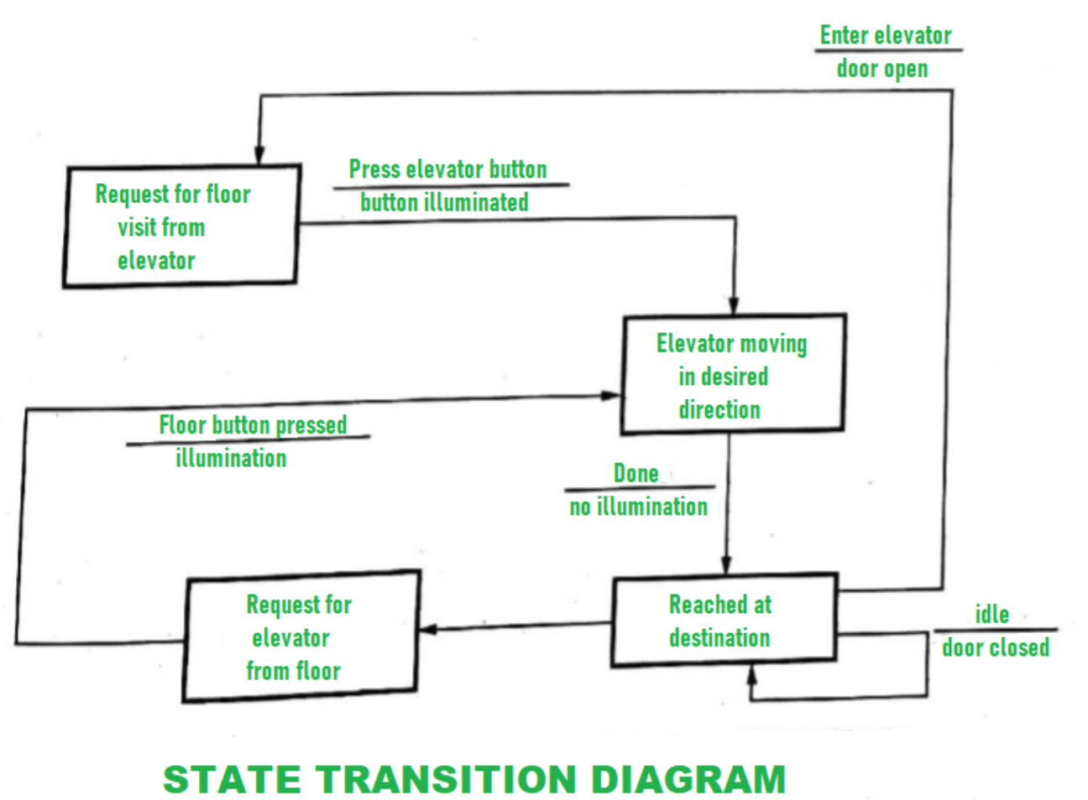
Example: State Transition Diagram

Slide 12
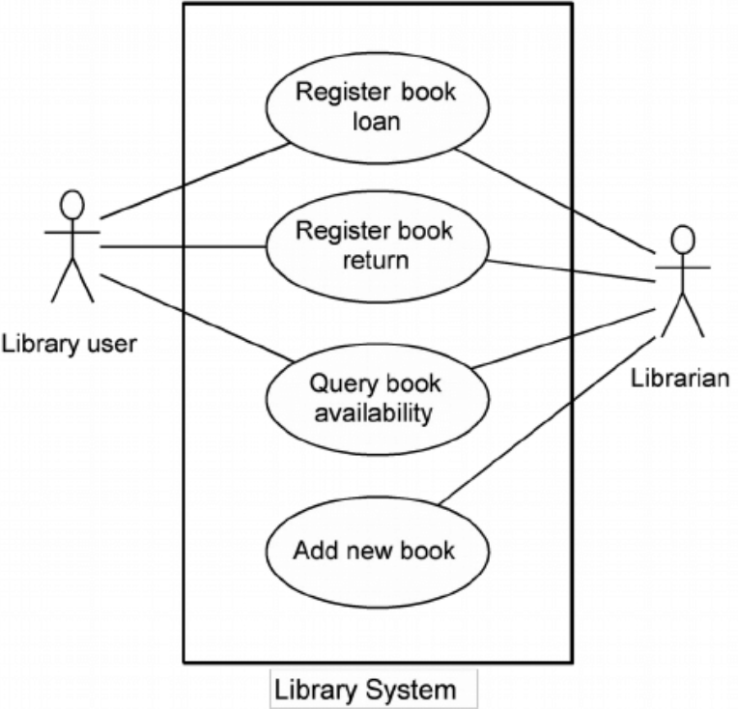
Example: Use case Diagram

Slide 13
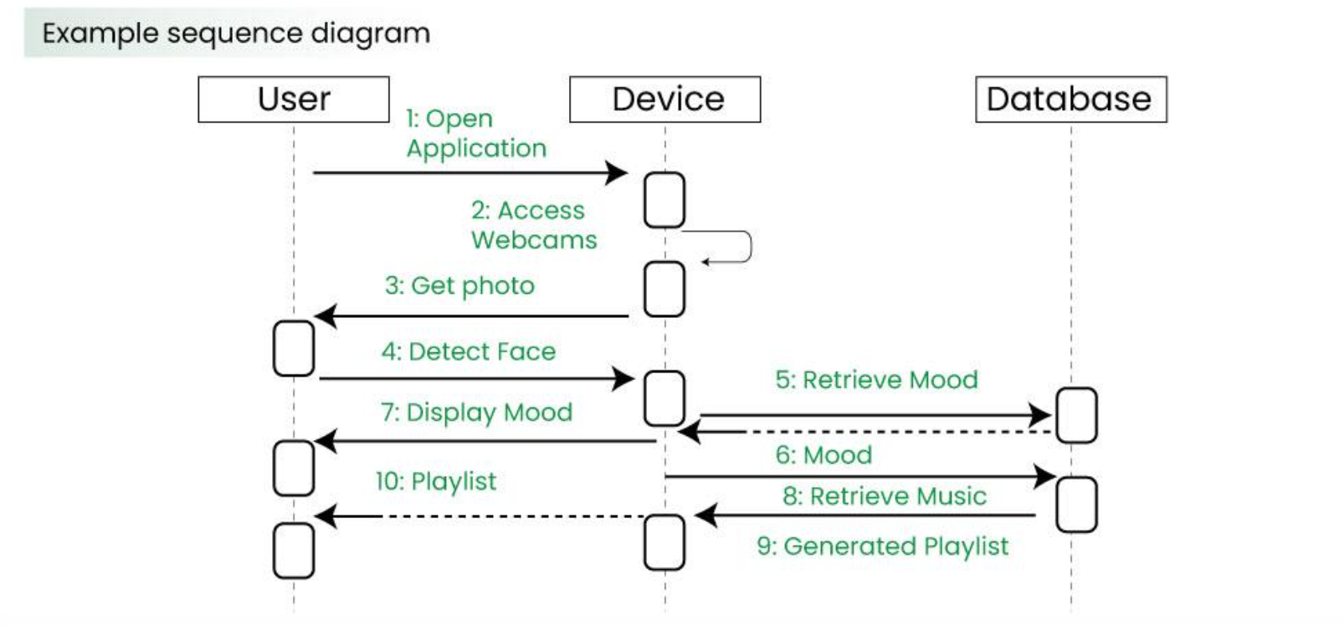
Example: Sequence Diagram

Slide 14
Domain Analysis and System Models : Data Models
Objective
Define how data is structured, stored, accessed, and manipulated.
Show the relationships between different data elements.
Approach
Entity-Relationship Diagrams (ERDs)
Identify entities (e.g., “User,” “Order,” “Product,” “Student,” “Course”).
Show relationships among these entities (e.g., “Student enrolls in Course,” “User places Order”).
Class Diagrams (in Object-Oriented Systems)
Define classes, attributes, methods, and relationships.
Example: A Student class with attributes like name, roll_number and methods like enroll(), dropCourse().
Relevance
Critical for database design.
Facilitates understanding of data flow through the system.
Ensures consistency in how information is managed (e.g., data integrity, relationships).
Example
School Management System:
ERD might include “Student,” “Teacher,” and “Course” with relationships like “Student enrolls in Course.”
Class Diagram could include classes for “Student,” “Teacher,” “Course,” each with its own set of attributes (like name, teacher_id) and methods.

Slide 15
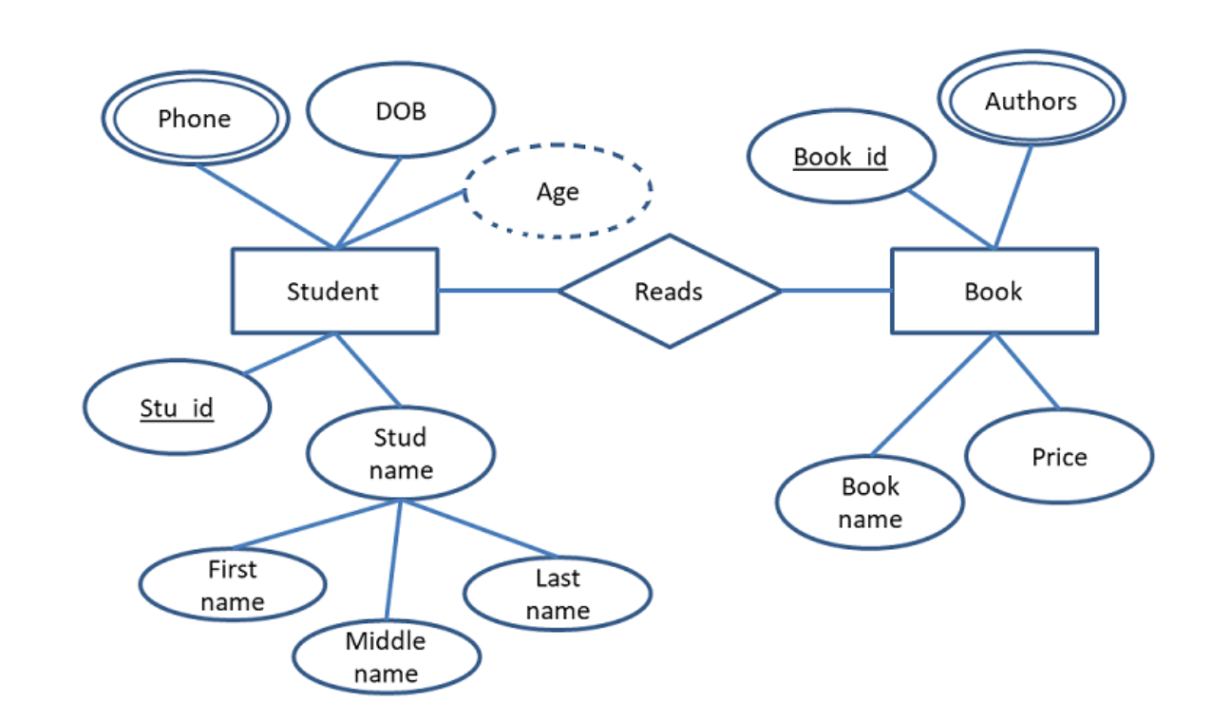
Example: ER Diagram

Slide 16
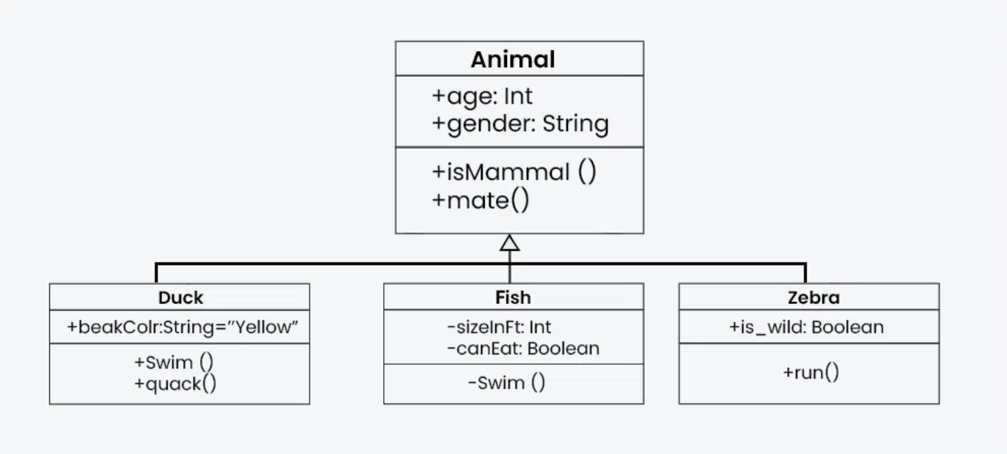
Example: Class Diagram

